Slide 1
Lecture # 25-26
Dr. M. Nadeem

Slide 2
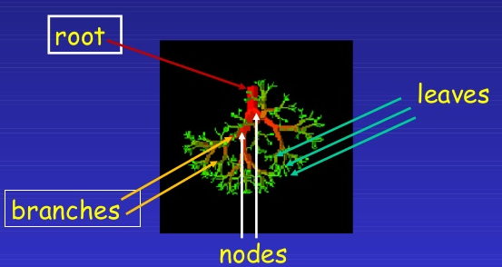
Tree

Slide 3
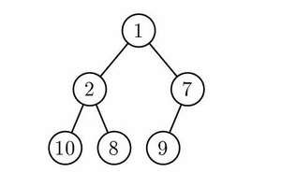
What is Tree?
An undirected graph is a tree if and only if there is a unique simple path between any two of its vertices.
Every Tree is a Graph ,but every Graph is not a tree.

Slide 4
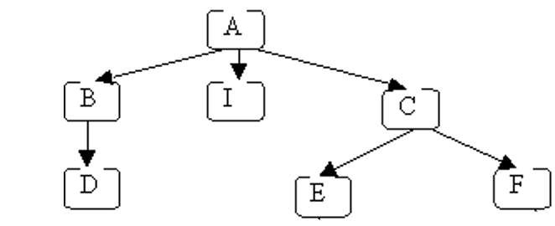
Basic Terminology of Tree
Node: A node is a fundamental part of a tree. Each letter represents one node.
Edge: The arrows from one node to another are called edges.

Slide 5
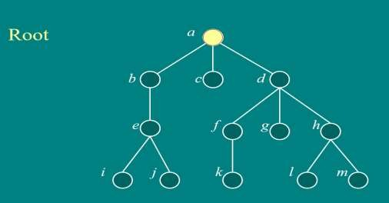
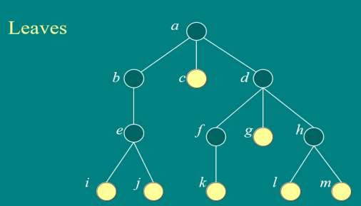
Basic Terminology of Tree
Root: The root of the tree is the only node in the tree that has no incoming edges.
Here, a is the root.
Leaf Node: A leaf node is a node that has no children.
The bottom nodes (with no outgoing edges) are the leaves .
Here, c , i , j , k , l , m are leaves Node.

Slide 6
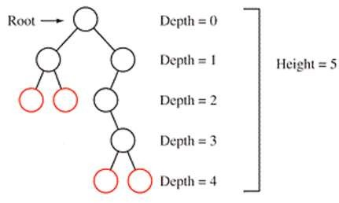
Basic Terminology of Tree
Depth: Depth tells the number of steps (nodes) to get from a node back to the root.
Height: The height of a tree is equal to the maximum level of any node in the tree.
This tree has height 5, so the maximum depth is 4 (height - 1).

Slide 7
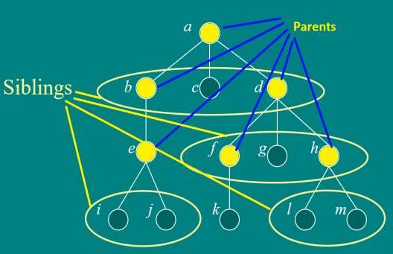
Basic Terminology of Tree
Parent:
a is the parent of b , c , d
b is the parent of e
d is the parent of f , g , h
e is the parent of i , j
f is the parent of k
h is the parent of l , m
Siblings:
b , c , d are siblings of each other
f , g , h are siblings of each other
i , j are siblings of each other
l , m are siblings of each other
Children:
b , c , d are children of a
f , g , h are children of d
e is the children of b
i , j are the children of e
k is the children of f
l , m are the children of h

Slide 8
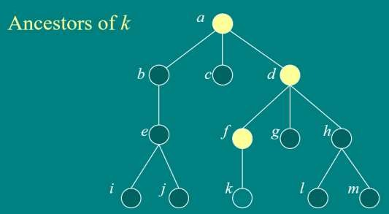
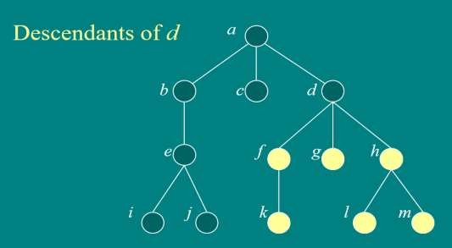
Basic Terminology of Tree

Slide 9
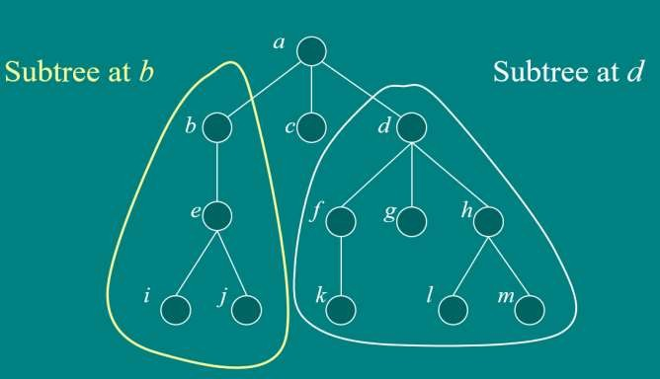
Basic Terminology of Tree
Sub-Tree: A sub-tree of a given node includes one of its children and all of that child's descendants.

Slide 10
Binary Search Trees
Support many dynamic set operations
SEARCH, MINIMUM, MAXIMUM, PREDECESSOR, SUCCESSOR, INSERT
Running time of basic operations on binary search trees
On average: Θ(lgn)
The expected height of the tree is lgn
In the worst case: Θ(n)
The tree is a linear chain of n nodes

Slide 11
Binary Search Trees
Tree representation:
A linked data structure in which each node is an object
Node representation:
Key field
Left: pointer to left child
Right: pointer to right child
Satisfies the binary-search-tree property
parent
L
R
key
Left child
Right child
Notes:
Object: combination of multiple attributes

Slide 12
Binary Search Trees Property
The left child of parent node is less than to the parent node
The right child of the parent node is greater than or equal to the parent node
Both left and right subtree must be Binary Search Trees

Slide 13
Binary Search Tree Example
Binary search tree property:
If y is in left subtree of x,
then key [y] < key [x]
If y is in right subtree of x,
then key [y] ≥ key [x]
5
3
7
2
5
9
Notes:
Key=value

Slide 14
Traversing a Binary Search Tree
Inorder tree walk:
Prints the keys of a binary tree in sorted order
Root is printed between the values of its left and right subtrees: left, root, right
Preorder tree walk:
root printed first: root, left, right
Postorder tree walk: left, right, root
root printed last
Inorder: 2 3 5 5 7 9
5
Preorder: 5 3 2 5 7 9
3
7
Postorder: 2 5 3 9 7 5
2
5
9

Slide 15
Searching for a Key
Given a pointer to the root of a tree and a key k:
Return a pointer to a node with key k
if one exists
Otherwise return NIL
Idea
Starting at the root: trace down a path by comparing k with the key of the current node:
If the keys are equal: we have found the key
If k < key[x] search in the left subtree of x
If k > key[x] search in the right subtree of x
5
3
7
2
4
9

Slide 16
Searching for a Key
Alg: TREE-SEARCH(x, k)
if x = NIL or k = key [x]
then return x
if k < key [x]
then return TREE-SEARCH(left [x], k )
else return TREE-SEARCH(right [x], k )
5
3
7
2
4
9
Running Time: O (h),
h – the height of the tree
Notes:
Recursive Algorithm
If x=NIL then output will be NILL means no data found (empty tree?) where x is a node
function Find-recursive(key, node): // call initially with node = root
if node = Null or node.key = key
then return node
else if key < node.key then
Return Find-recursive(key, node.left)
else
return Find-recursive(key, node.right)

Slide 17
Example: TREE-SEARCH
15
Search for key 13:
15 → 6 → 7 → 13
6
18
3
7
17
20
2
4
13
9

Slide 18
Iterative Tree Search
Alg: ITERATIVE-TREE-SEARCH(x, k)
while x ≠ NIL and k ≠ key [x]
do if k < key [x]
then x ← left [x]
else x ← right [x]
return x
Notes:
while x ≠ NIL and k ≠ key [x] means that stop when x=NIL of k=key[x]

Slide 19
Height of a tree
Height of a tree
Start counting from the leaf node
The height of a leaf node is zero
Count the in between nodes from deepest leaf to parent
Height of this tree is = 4
15
6
18
3
7
17
20
2
4
13
9

Slide 20
Finding the Minimum in a Binary Search Tree
Goal: find the minimum value in a BST
Following left child pointers from the root, until a NIL is encountered
Alg: TREE-MINIMUM(x)
while left [x] ≠ NIL
do x ← left [x]
return x
Running time: O(h), h – height of tree
15
6
18
3
7
17
20
2
4
13
9
Minimum = 2

Slide 21
Finding the Maximum in a Binary Search Tree
Goal: find the maximum value in a BST
Following right child pointers from the root, until a NIL is encountered
Alg: TREE-MAXIMUM(x)
while right [x] ≠ NIL
do x ← right [x]
return x
Running time: O(h), h – height of tree
15
6
18
3
7
17
20
2
4
13
9
Maximum = 20

Slide 22
Successor
Def: successor (x ) = y, such that key [y] is the smallest key > key [x]
E.g.: successor (15) =
successor (13) =
successor (9) =
Case 1: right (x) is non empty
successor (x ) = the minimum in right (x)
Case 2: right (x) is empty
Find the current node that is a left child by moving in a tree up:
successor (x ) is the parent of the current node
if you cannot go further (and you reached the root): x is the largest element (means x is successor)
15
17
15
6
18
13
3
7
17
20
2
4
13
9
Notes:
Note for last point:if you cannot go further (and you reached the root): x is the largest element and it will be its successor itself
Note: key[x] refers to value of node x

Slide 23
Successor
Def: successor (x ) = y, such that key [y] is the smallest key >= key [x]
E.g.: successor (4) =
successor (17) =
successor (20) =
successor (18) =
successor (2) =
successor (3) =
successor (6) =
6
15
18
20
6
18
20
3
7
17
20
3
2
4
13
4
9
7
Successor of 4 is 6 using case-II part I.
Successor of 17 is 18 using case-II part I.
Successor of 20 is 20 using case-II part II.
Successor of 18 is 20 using case-II part I.
Successor of 2 is 3 using case-II part I.
Successor of 3 is 4 using case-II part I.
Successor of 6 is 7 using case-II part I.
Notes:
Parent of 7 is smallest in its right since its right is non-empty

Slide 24
Finding the Successor
Alg: TREE-SUCCESSOR(x)
if right [x] ≠ NIL
then return TREE-MINIMUM(right [x])
y ← p[x]
while y ≠ NIL and x = right [y]
do x ← y
y ← p[y]
If(y=NIL)
return TREE-Maximum(x)
else
return y
Running time: O (h), h – height of the tree
15
y
6
18
3
7
17
20
x
2
4
13
9
Notes:
I have added Red lines in main algorithm (that will work for maximum value only)
P[x] is parent of x
P[y] is parent of y
while y ≠ NIL and x = right [y] it will ensure that the node is not nill and we are moving to the current node
do x ← y it will move x one step up towards y (mean copy y in x that is move value of y in x to move x at the position of y)
y ← p[y] it will move y at its parent node/move y one step up
Exp. If x is at 4, start execution
Right[4]=NIL False
Ignore it
Y=p[4]=3
While (3!=NIL & 4=right[3] //Iteration number-I (both are true)
x = 3
y = p[y] = p[3] = 6
While (6!=NIL & 3!=right[3] //Iteration number-II ((First condition is true and second is false so false))
Ignore it
Ignore it
Return 6 and 6 is the successor of 4

Slide 25
Explanation(Case-I and Case-II)
if right [x] ≠ NIL % this is for case-1
then return TREE-MINIMUM(right [x])
y ← p[x] //this is for case-II, to find parent(y) of current node by moving in a tree up order
while y ≠ NIL and x = right [y]
do x ← y //to move up x
y ← p[y] //to move up y
return y //is = successor(x)
Notes:
P[x] is parent of x
P[y] is parent of y
while y ≠ NIL and x = right [y] it will ensure that the node is not nill and we are moving to the current node
do x ← y it will move x one step up towards y (mean copy y in x that is move value of y in x to move x at the position of y)
y ← p[y] it will move y at its parent node/move y one step up
Exp. If x is at 4, start execution
Right[4]=NIL False
Ignore it
Y=p[4]=3
While (3!=NIL & 4=right[3] //Iteration number-I (both are true)
x = 3
y = p[y] = p[3] = 6
While (6!=NIL & 3!=right[3] //Iteration number-II ((First condition is true and second is false so false))
Ignore it
Ignore it
Return 6 and 6 is the successor of 4

Slide 26
Predecessor
Def: predecessor (x ) = y, such that key [y] is the biggest key < key [x]
E.g.: predecessor (15) =
predecessor (9) =
predecessor (13) =
Case 1: left (x) is non empty
predecessor (x ) = the maximum in left (x)
Case 2: left (x) is empty
Find the current node is a right child by moving up in tree
: predecessor (x ) is the parent of the current node
if you cannot go further (and you reached the root): predecessor(x)-is the smallest element
15
13
7
6
18
9
3
7
17
20
2
4
13
9

Slide 27
Predecessor
Def: predecessor (x ) = y, such that key [y] is the smallest key > key [x]
E.g.: predecessor(4) =
predecessor (7) =
predecessor (20) =
predecessor (13) =
predecessor (18) =
predecessor (2) =
predecessor (3) =
predecessor (6) =
predecessor (9) =
predecessor (17) =
predecessor (9) =
3
15
6
18
6
18
9
3
7
17
20
17
2
4
13
2
9
2
4
7
15
7
predecessor of 4 is 3 using case-II part I. predecessor of 7 is 6 using case-II part I.
predecessor of 20 is 18 using case-II part I. predecessor of 13 is 7 using case-II part I.
predecessor of 18 is 15 using case-II part I. predecessor of 2 is 2 using case-II part II.
predecessor of 3 is 2 using case-II part I. Etc etc

Slide 28
Finding the Predecessor
Alg: TREE-Predecessor (x)
if left [x] ≠ NIL
then return TREE-Maximum(left [x])
y ← p[x]
while y ≠ NIL and x = left [y]
do x ← y
y ← p[y]
If(y=NIL)
return TREE-Minimum(x)
else
return y
Running time: O (h), h – height of the tree
15
y
6
18
3
7
17
20
x
2
4
13
9
Notes:
I have added Red lines in main algorithm (that will work for maximum value only)
P[x] is parent of x
P[y] is parent of y
while y ≠ NIL and x = right [y] it will ensure that the node is not nill and we are moving to the current node
do x ← y it will move x one step up towards y (mean copy y in x that is move value of y in x to move x at the position of y)
y ← p[y] it will move y at its parent node/move y one step up
Exp. If x is at 4, start execution
Right[4]=NIL False
Ignore it
Y=p[4]=3
While (3!=NIL & 4=right[3] //Iteration number-I (both are true)
x = 3
y = p[y] = p[3] = 6
While (6!=NIL & 3!=right[3] //Iteration number-II ((First condition is true and second is false so false))
Ignore it
Ignore it
Return 6 and 6 is the successor of 4

Slide 29
Insertion
Goal:
Insert value v into a binary search tree
Idea:
If key [x] < v move to the right child of x,
else move to the left child of x
When x is NIL, we found the correct position
If v < key [y] insert the new node as y’s left child
else insert it as y’s right child
Begining at the root, go down the tree and maintain:
Pointer x : traces the downward path (current node)
Pointer y : parent of x (“trailing pointer” )
Insert value 13
12
5
18
2
9
15
19
1
3
13
17
Notes:
We can say x as current node and y as previous node or parent of current, in case of root node y will be Nill

Slide 30
Example: TREE-INSERT
Insert 13:
x, y=NIL
y
12
12
x
5
18
5
18
2
9
15
19
2
9
15
19
1
3
17
1
3
17
12
12
x
y
5
18
5
18
2
9
15
19
2
9
15
19
1
3
17
1
3
13
17
x = NIL
y = 15

Slide 31
Alg: TREE-INSERT(T, z)
y ← NIL
x ← root [T]
while x ≠ NIL
do y ← x
if key [z] < key [x]
then x ← left [x]
else x ← right [x]
p[z] ← y y is parent of…
if y = NIL inserting node
then root [T] ← z Tree T was empty
else if key [z] < key [y]
then left [y] ← z
else right [y] ← z
12
5
18
2
9
15
19
1
3
13
17
Running time: O(h)
Notes:
Y=Nill is the parent of x(current) and starting current is a root node, P[z]=y, means set the parent of z=y
Step 3 is used to find the inserting position.
Step 4 assign x to y i.e move x to downward and y will keep the position of x as a parent of x.
Step 5-7 decide whether to move to left or right of the tree, at the end of this while we have found the insertion location i.e x
Step 8 says that assign y to parent of z, since x will be replaced as z
Step-9. if y=nill means tree is empty and inserting node must be the root node(step-10)
Step-11-13 decides whether z should be the right child or the left child of the tree

Slide 32
Binary Search Trees - Summary
Operations on binary search trees:
SEARCH O(h)
PREDECESSOR O(h)
SUCCESOR O(h)
MINIMUM O(h)
MAXIMUM O(h)
INSERT O(h)
DELETE O(h)
These operations are fast if the height of the tree is small – otherwise their performance is similar to that of a linked list

